Slide 1
European
Network of
Earth Observation
Networks
Plenary Workshop
Building a collaborative ENEON to inform policies and actions to address complex societal challenges
The Future of ENEON
Ian McCallum
12 - 13 October 2016
IIASA. Schlossplatz 1 - A-2361 Laxenburg, Austria

Slide 2
Existing NoNs
ENVRI+
GEOBON
OBIS
GFOI
FTNH
GNON
SAON
CAFF
ESP
GGMN
EOOS
…

Slide 3
EOOS
A coordinating framework designed to align and integrate Europe’s ocean observing capacity
studies demonstrate the economic benefit of the integration of ocean observing efforts
capability, especially in the seaborne (in situ) observations, is highly fragmented
EOOS will be a light body

Slide 4
Possible Futures – ENEON: a Virtual Marketplace/Commons
ENEON might benefit from being restructured along the lines of a virtual marketplace (“commons”) – essentially a space where EO in-situ suppliers and consumers could meet and interact with the EO community at large.
Such a commons could have at its core a facilitator (e.g. EC, GEOSS, EARSC, others).
This platform could also eventually offer services and facilities helping the in-situ community to grow and increase their opportunities and joint collaboration.
Source: CLOUDEO

Slide 5
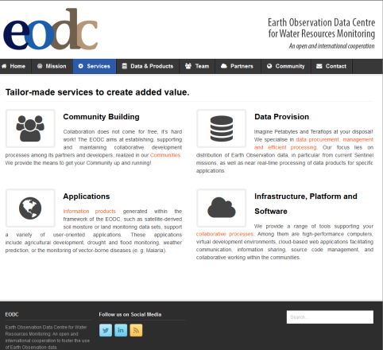
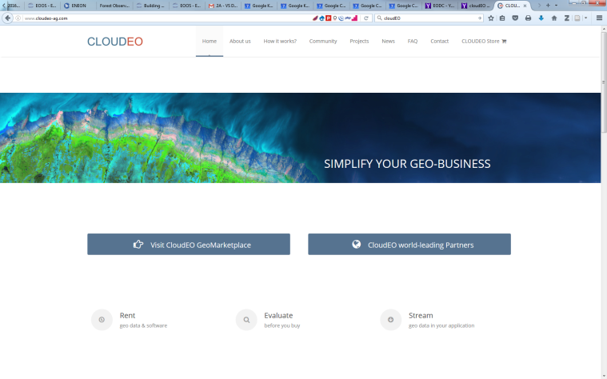
ENEON: a Virtual Marketplace/Commons
Virtual marketplaces are on the rise e.g. Uber and AirBnB
For EO data with a satellite focus:
http://www.cloudeo-ag.com/ https://www.eodc.eu/mission/.
A similar structure for ENEON to service the EO in-situ community might prove beneficial to both users and contributors.

Slide 6
ENEON: a Virtual Marketplace/Commons
To test the commons approach, ConnectinGEO recommends the creation of a pilot demonstration (e.g. Solar).
This pilot will be in disciplines that have an active in-situ component and can be paired to address interdisciplinary effectiveness.
The Commons will facilitate exchange and will also monitor activities and effectiveness.
Metrics will be defined at the ENEON workshop.

Slide 7
Discussion Topics
What is the niche of an ENEON and how best to complement existing NoNs in Europe
Migrating ENEON Social Network/virtual marketplace
Sustainability of ENEON - Considerations of a Pilot ENEON, inclusion into GEO as a NoN
Funding Possibility: ERA-PLANET, NextGEOSS, COST Action, ERIC

Slide 8
ERA-PLANET

Slide 9
Timeline
Architecture and construct – 1 month – Initial demo at GEO Plenary November 7th
Outreach to appropriate communities to get feedback (beta test) – completed December 15.
Pilot open for business with advertising to target community – Jan 1 –Feb 15
Final recommendation based on Pilot experience

Slide 10
Thankyou

Slide 11
ENEON: a Virtual Marketplace/Commons
Furthermore, the ENEON should play a major role in developing, validating, populating, and using the Socio-Economic and Environmental Information Needs Knowledge Base (SEE-IN KB) for virtual collaboration between providers, scientific and societal users, and, in particular, decision and policy makers.

